Slide 1

Front-End Automation
DEVP-600-001 Business Innovation with Development Operations (DevOps)
Hai Nam Nguyen
Xuan Hieu Nguyen
Cong Chi Tai Nguyen

Slide 2
Problem Definition
Version control
Deployment environment
Build and Deployment Process

Slide 3
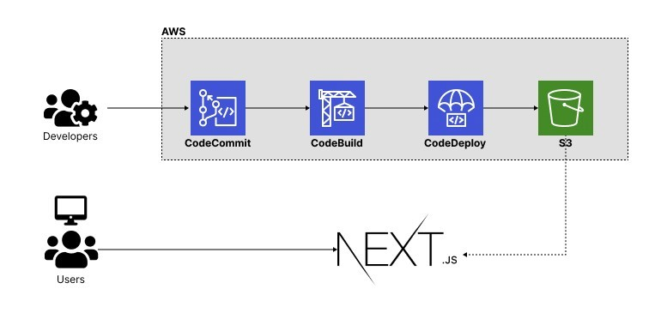
Architecture

Slide 4
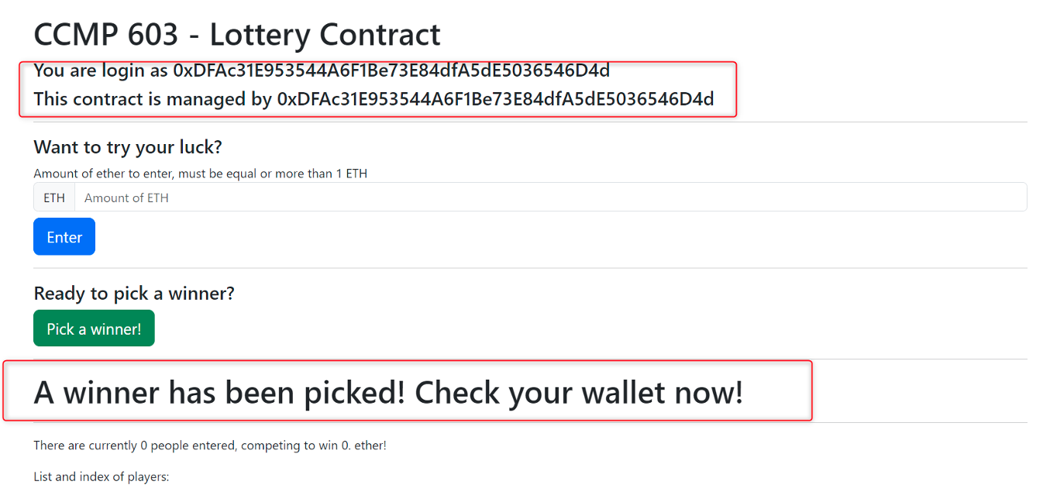
Front-end

Slide 5
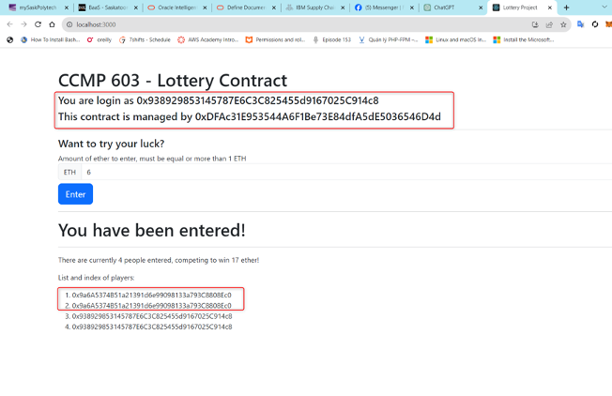
Front-end (cont)

Slide 6
Implementation Stages
Setting Up Version Control with AWS CodeCommit
Building and Testing with AWS CodeBuild
Deployment Automation with AWS CodeDeploy
Configuring AWS S3 Bucket for Storage
DNS Configuration with AWS Route 53

Slide 7
Conclusion
Reducing human mistakes, inconsistencies, and unexpected failures.
Assuring consistency and reliability in deployment environments.
Enabling collaboration among team members.
Offering speed, efficiency, and high-quality delivery by automating tasks.

Slide 8
THANK YOU FOR YOUR TIME
Q&A

